Slide 2
Outline
Introduction
Motivation
System Overview
Local Positioning System Design
Formation Control System Design
Results
Conclusion and Future Works
References

Slide 3
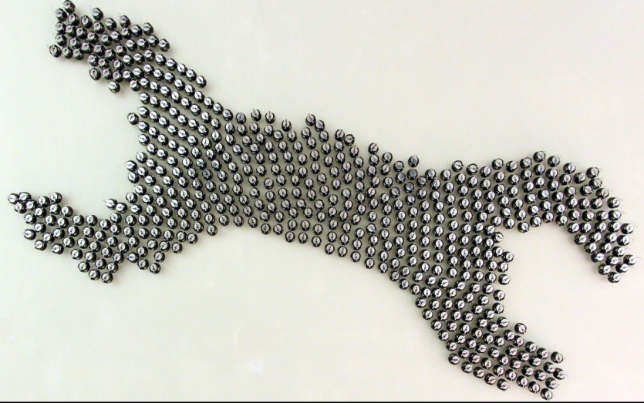
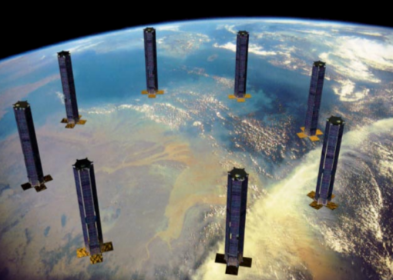
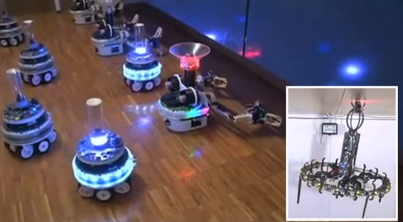
Introduction
This thesis work focuses on dynamic adaptation to achieve changes in formation of swarms consisting of heterogenous mobile robots
[1]
[2]
[3]

Slide 4
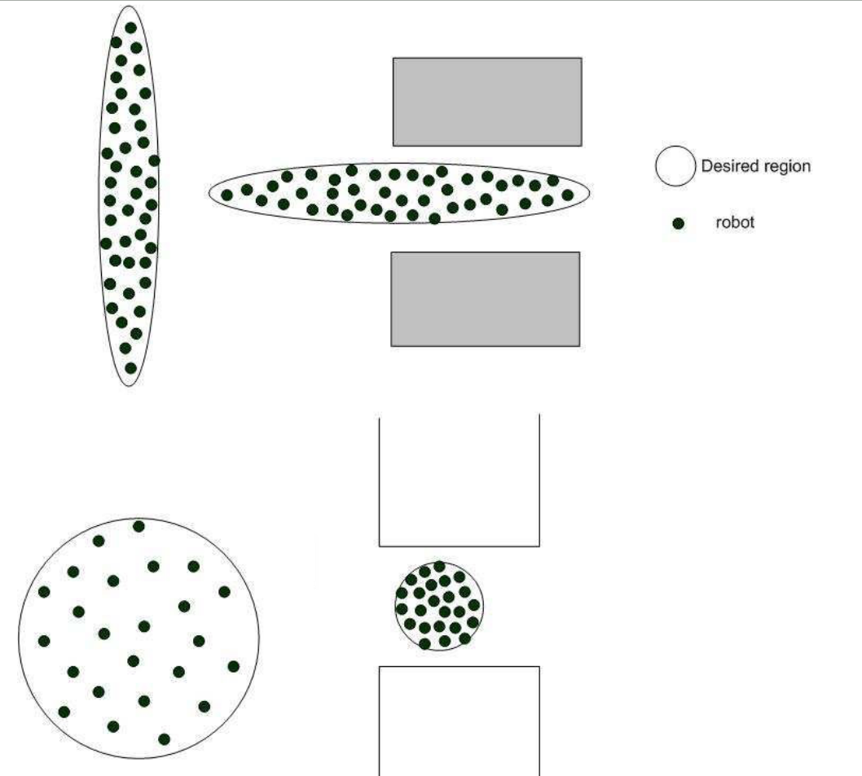
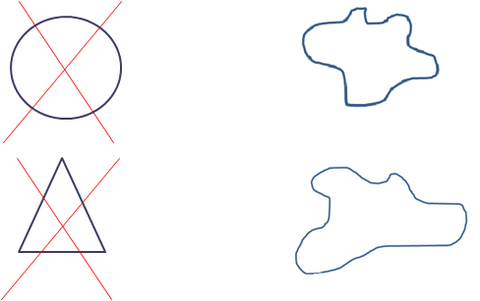
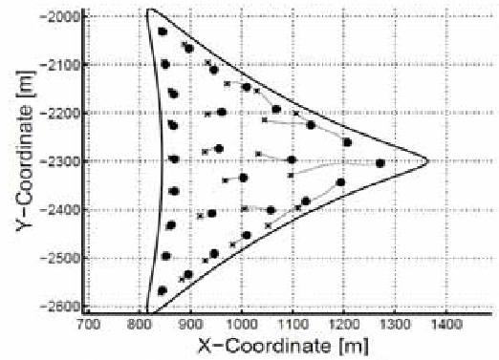
Motivation - 1
Formation control solutions are generally implemented with simple geometrical shapes which don’t change with time.
Our aim
Designing a formation control system for complex and dynamically changing shapes
[8]
[9]

Slide 5
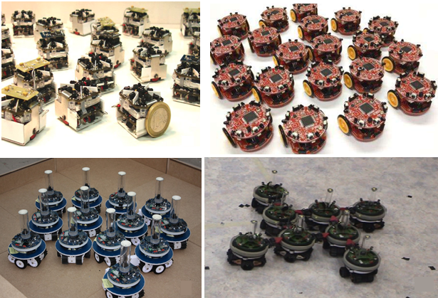
Motivation - 2
The research about the formation control, mainly focuses on swarms with homogenous agents.
Our aim
Designing a formation control system with heterogeneous agents
[4]
[5]
[6]
[7]

Slide 6
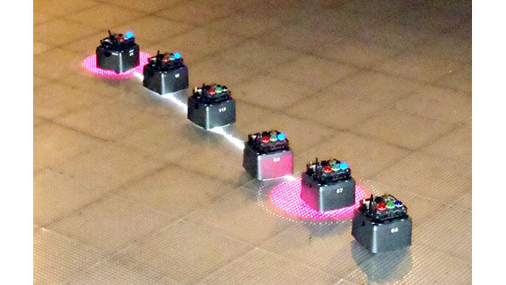
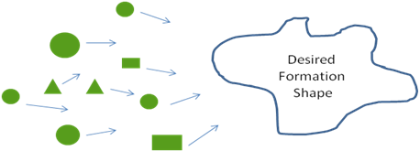
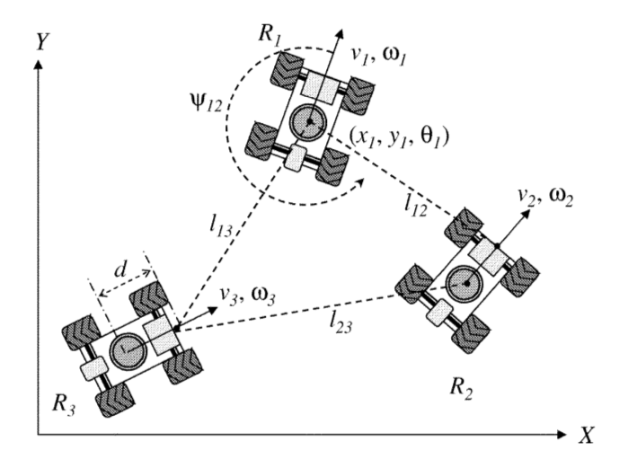
Motivation - 3
Centralized topologies create single point of failure type systems. We aim to implement a decentralized solution to increase the robustness of the system.
Our aim
Designing a formation control system with a decentralized topology
[10]
[11]

Slide 7
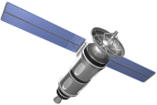
Motivation - 4
Most of the related works assume that the position data is always available (i.e. can be measured) for each agent in the workspace.
Our aim
Designing a local positioning system to provide position information to the second type agents with the help of position beacons.
???
Gps
???
???
???
Gps
???

Slide 8
System Overview
LOCAL POSITIONING SYSTEM
FORMATION CONTROL SYSTEM
Local Trilateration
Route Table
Algorithms
State Estimator
Formation Control
Agent
Dynamics
State Propogation
Inertial Sensors
Dynamically Changing Formation Shape
METU Electrical & Electronics Engineering Department

Slide 9
Local Positioning System (LPS)
Local positioning system is composed of two main parts.
Local Trilateration
Calculates the positions of the second type agents using position beacons as their direct neighbors.
Route Table Determination
Determines the route tables for agents in the swarm.
METU Electrical & Electronics Engineering Department

Slide 10
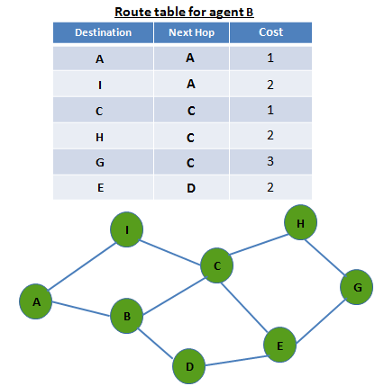
Local Positioning System (LPS)
1)Route Table Determination
Destination-Sequenced Distance Vector Routing Protocol (DSDV) algorithms
are used to create the route tables.
METU Electrical & Electronics Engineering Department

Slide 11
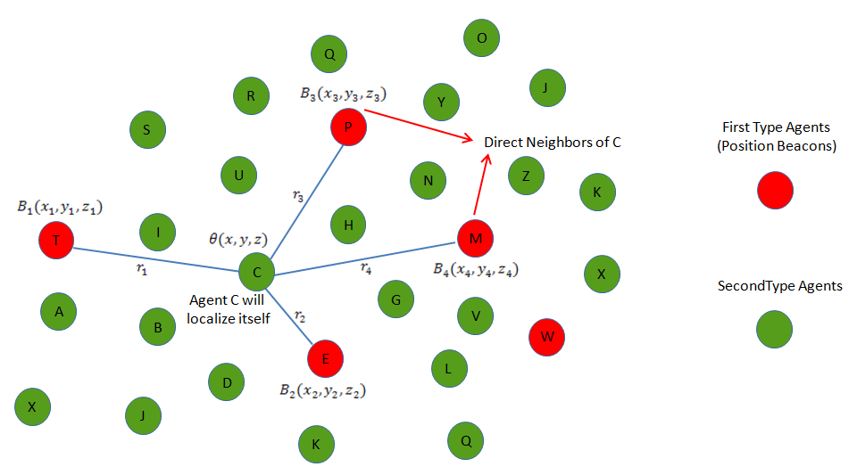
Local Positioning System (LPS)
2)Local trilateration
Calculates the position of an agent with the help of position beacons which are direct neighbors.
METU Electrical & Electronics Engineering Department

Slide 12
Formation Control System
Three different approaches are used to design the formation control system in this thesis work.
Formation Control Strategies
Potential Field Based Approach
Shape Partitioning Based Approaches
1) Artificial Forces Method
2) Bubble Packing Method
3) Randomized Fractals Method
Directly calculates control laws based upon potential fields
Partitions the desired formation shape into goal states
Implements an algorithm to assign agents to goal states

Slide 13
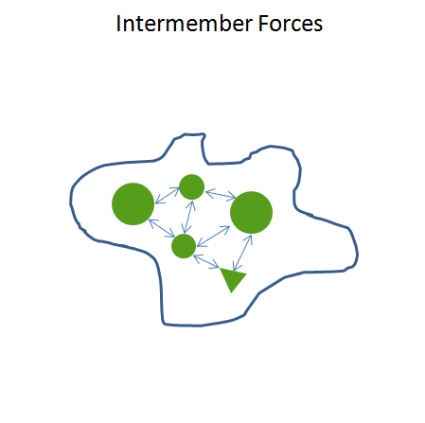
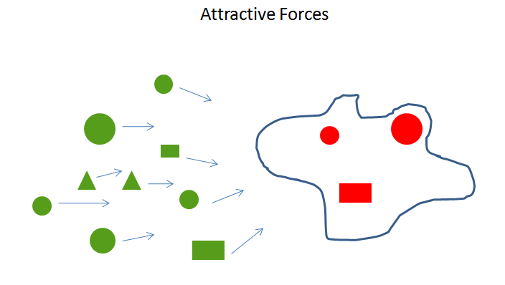
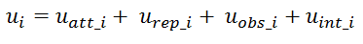
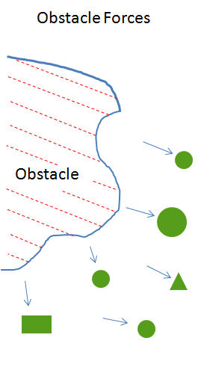
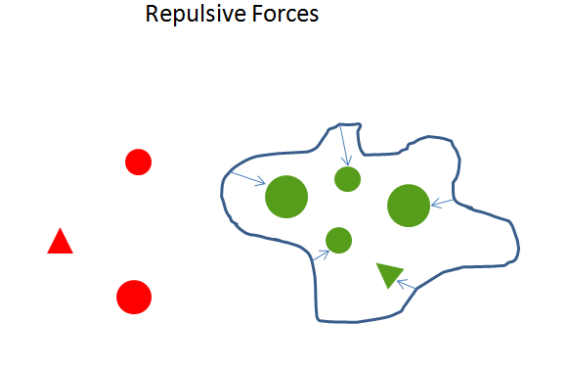
Formation Control System
Artificial Forces Method
Directly defines the control law for individuals with different potential field components.

Slide 14
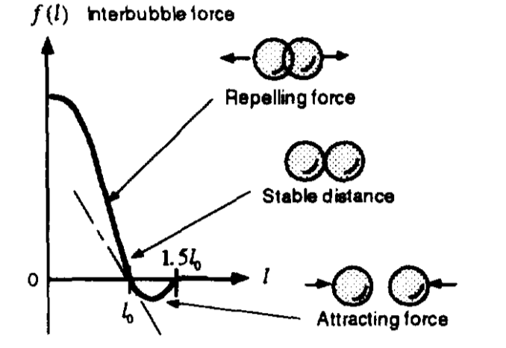
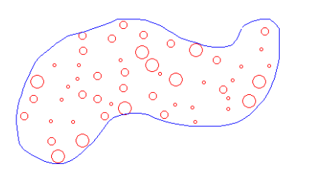
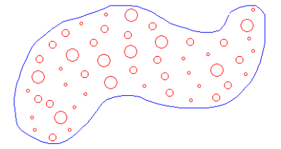
Formation Control System
Shape Partitioning Based Approaches – Partitioning Process
These two methods partition the desired formation shape into goal states with different approaches.
Bubble Packing
Randomized Factals
[12]

Slide 15
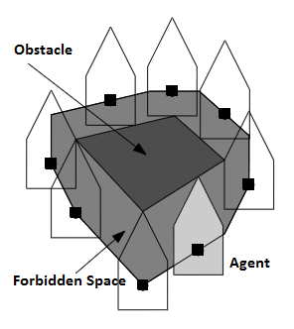
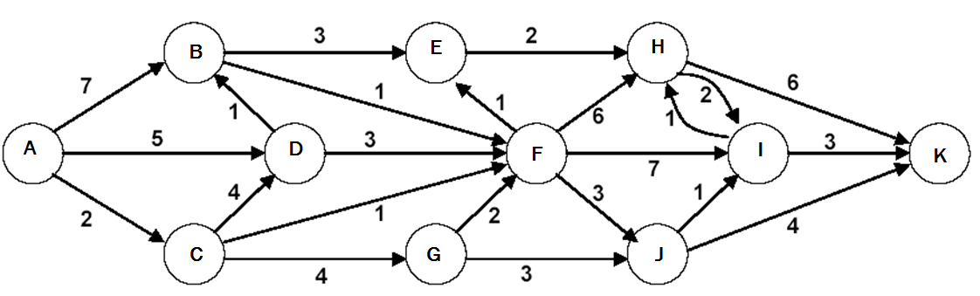
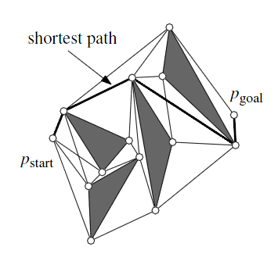
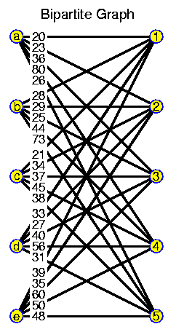
Formation Control System
Shape Partitioning Based Approaches – Assignment Process
The procedure of the assignment of the agents to the goal states are identical.
1)Calculation of Free Configuration Space
3)Dijkstra’s Algorithm
[15]
[14]
Calculation of Minimum Shortest Path From A to K
Forbidden Space
2)Visibility Graphs
4)Hungarian Algorithm (Munkres Assignment Algorithm)
[14]
Visibility Graph

Slide 16
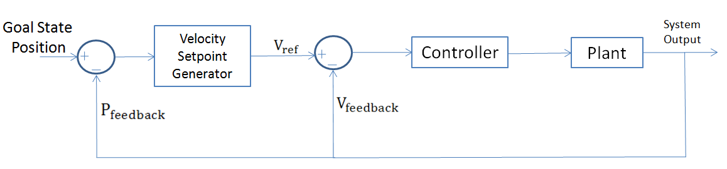
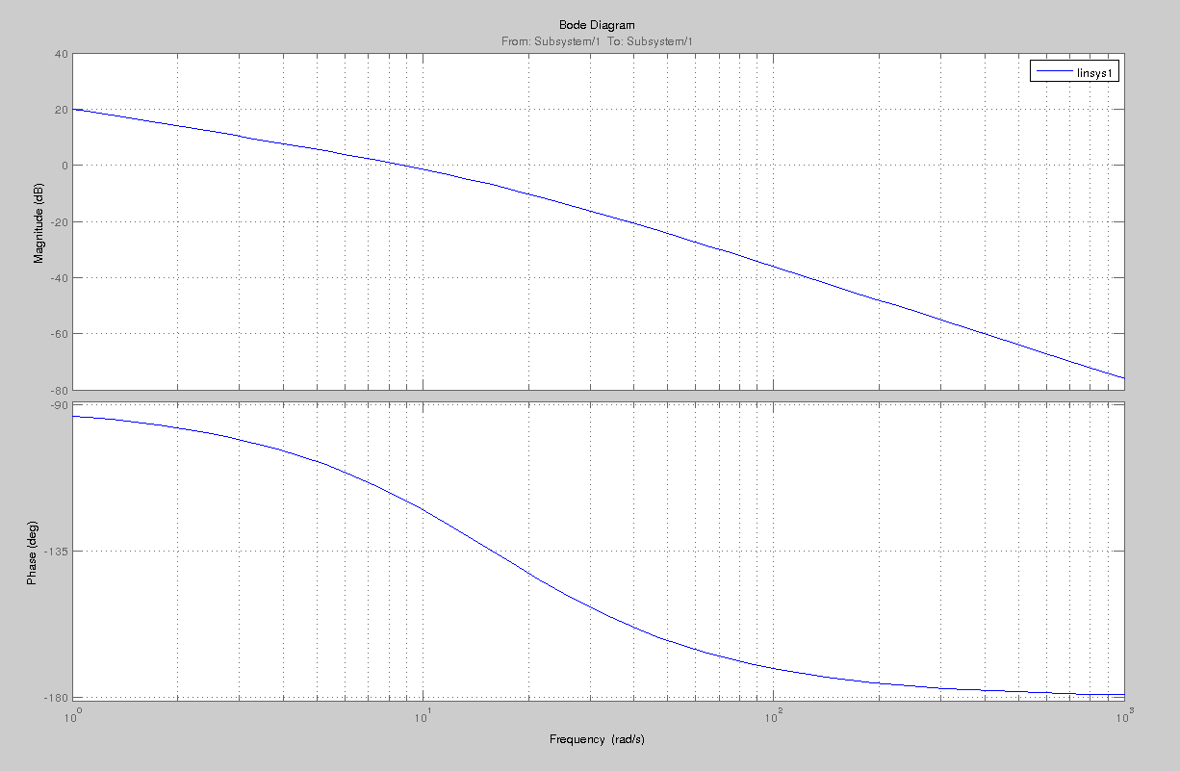
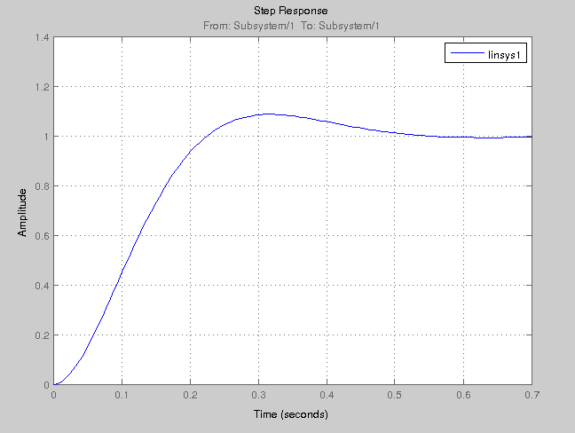
Formation Control System
Shape Partitioning Based Approaches – Navigation Control
Navigation to Goal States
Open loop Bode plots
Step response

Slide 17
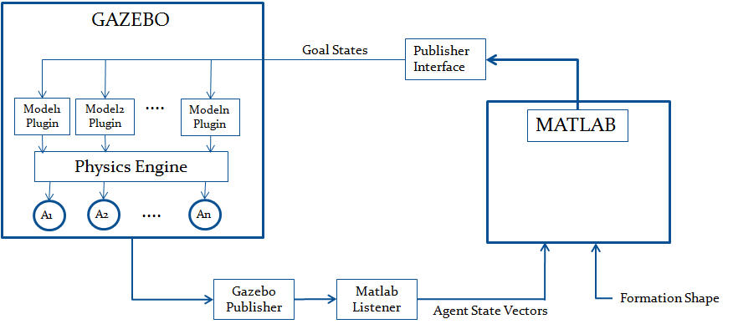
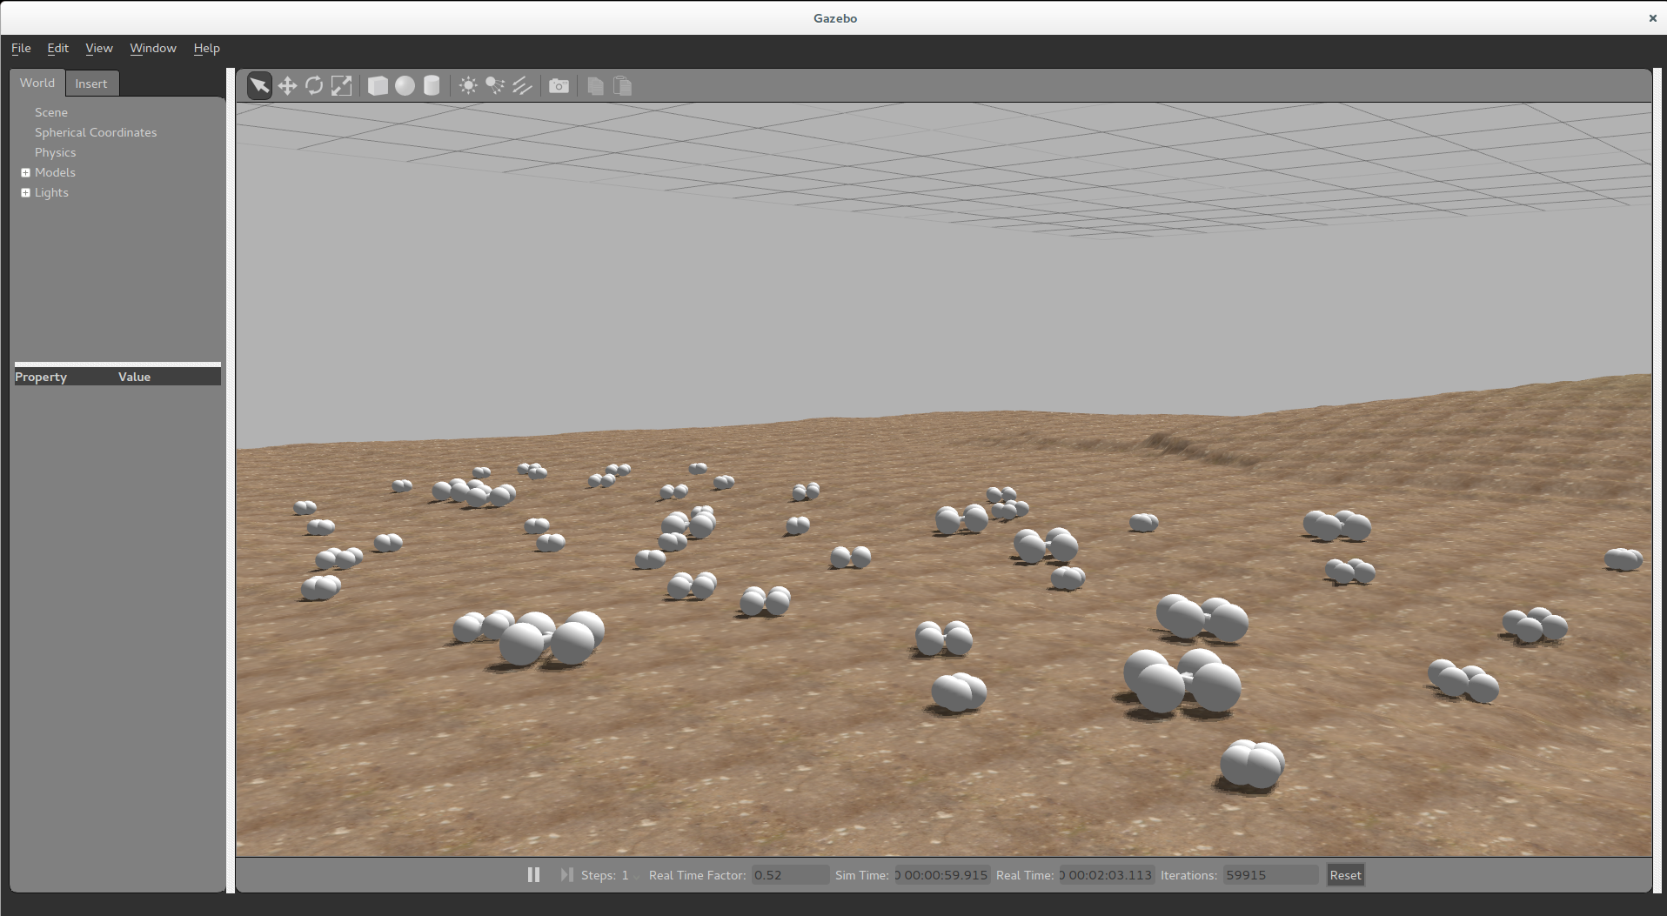
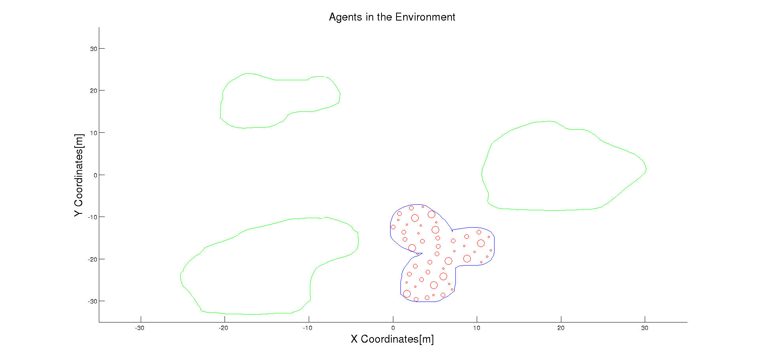
Simulation Results
Proposed solutions are implemented in a simulation environment.
Gazebo Environment
Matlab Environment

Slide 18
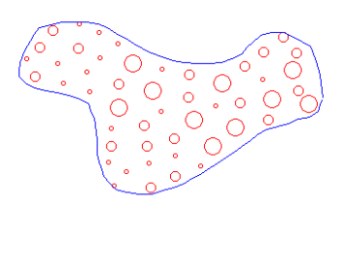
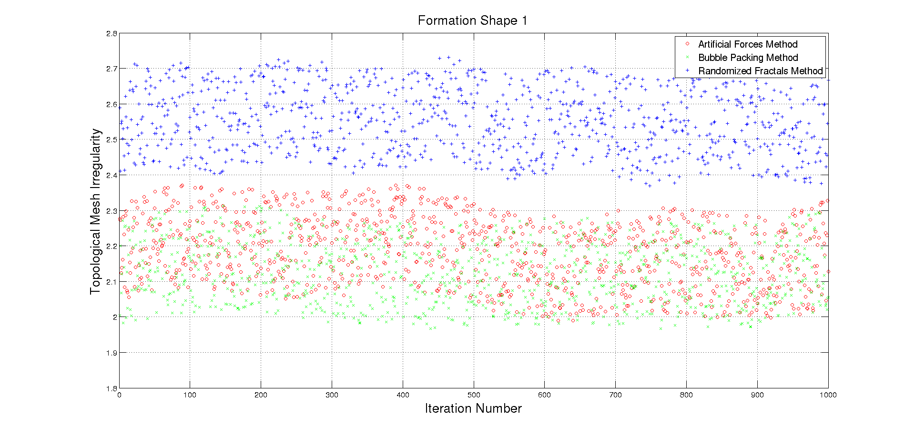
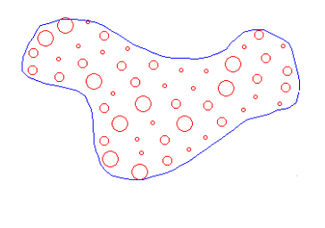
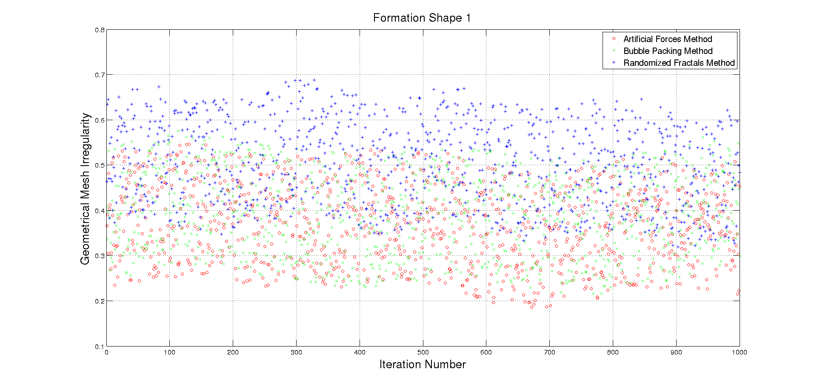
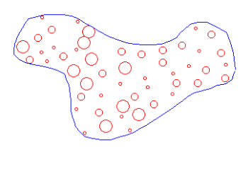
Simulation Results – Mesh Quality
Artificial Forces Method
Bubble Packing Method
Randomized Fractals Method

Slide 19

Simulation Results – Comparison of 3 Different Methods
Comparison of different solution methods are illustrated in Table -1
Table -1
Method/ Metric | Total Displacement | Settling Time | Mesh Quality
Artificial Forces
Bubble Packing
Randomized Fractals

Slide 20
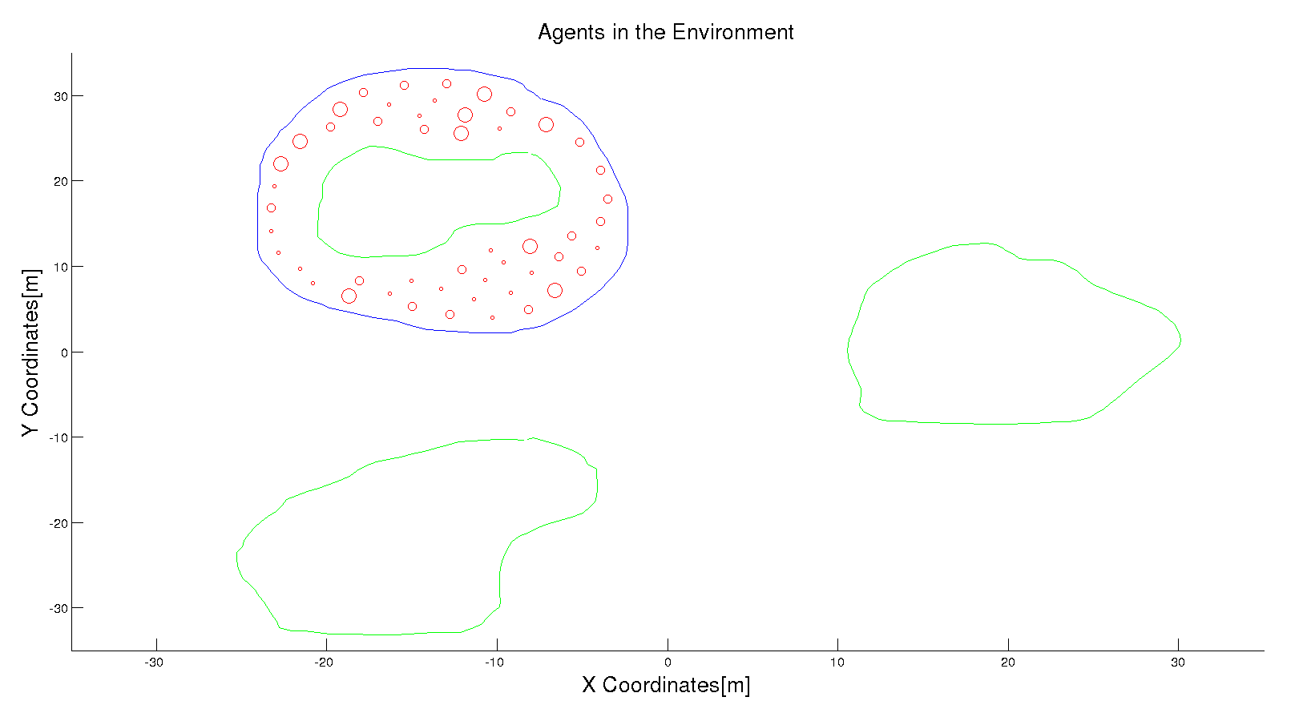
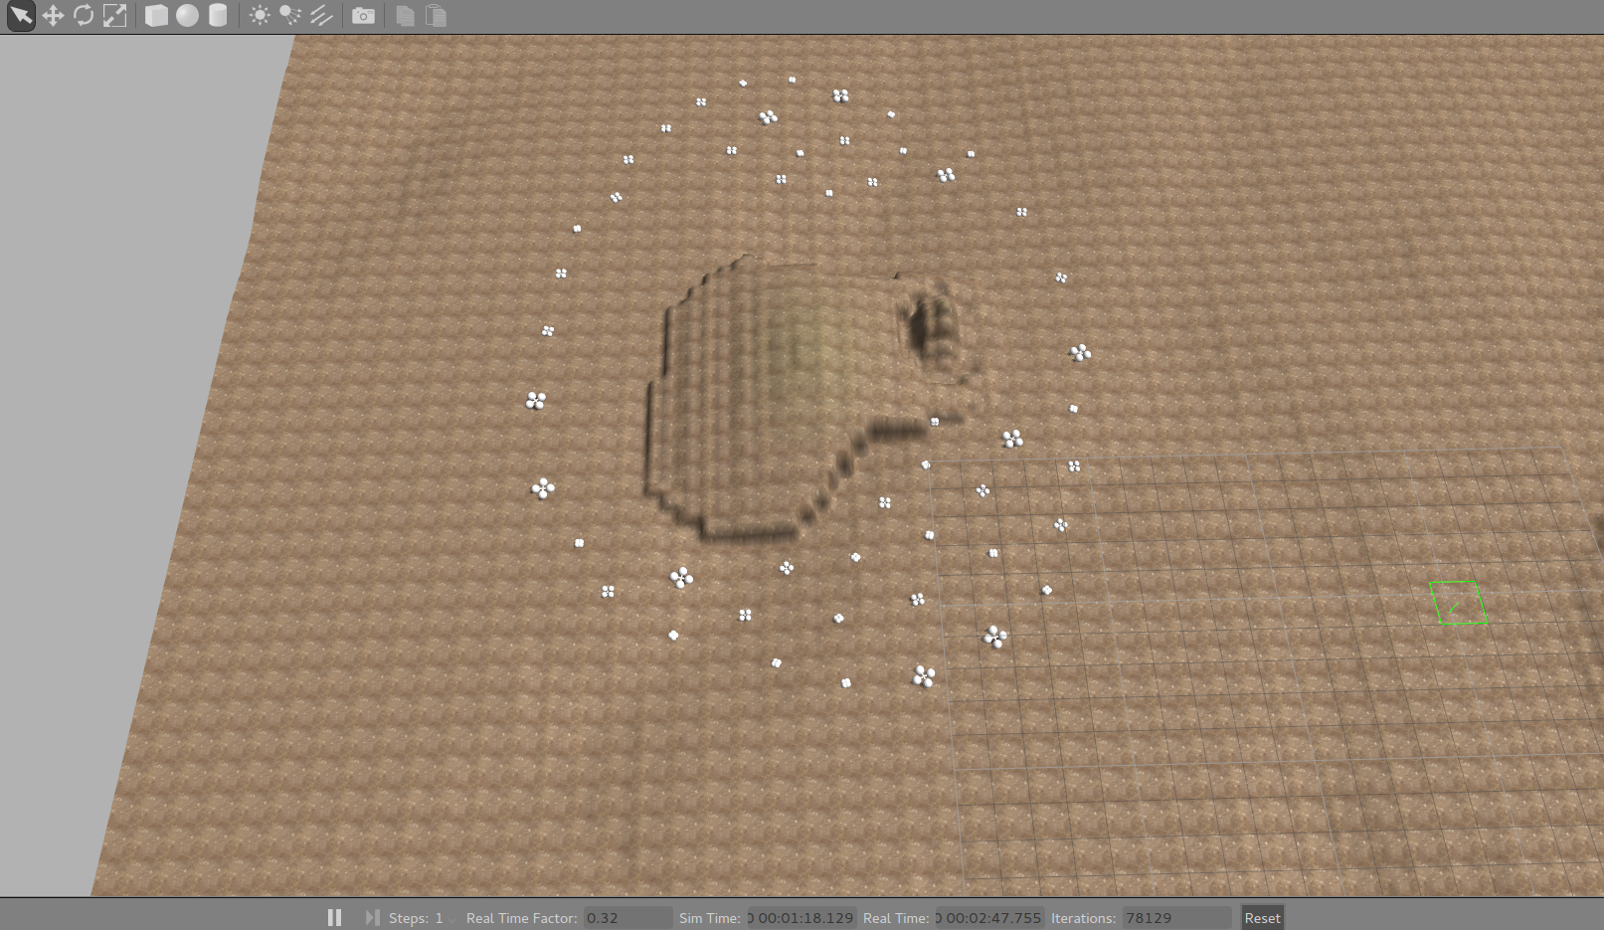
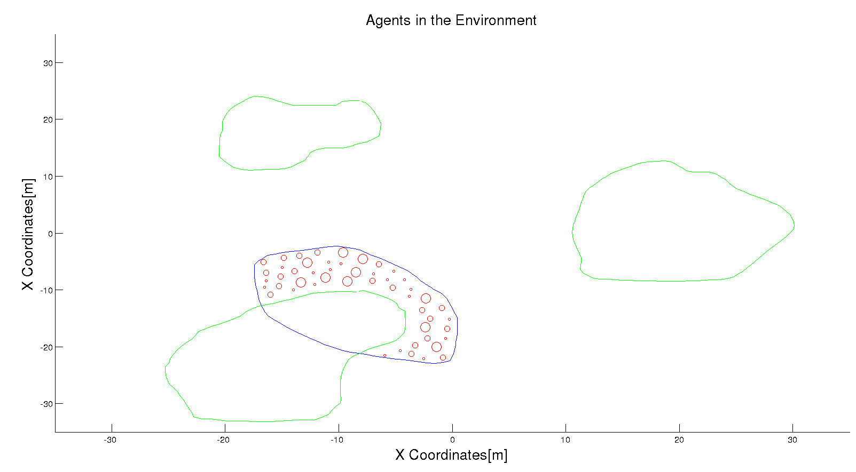
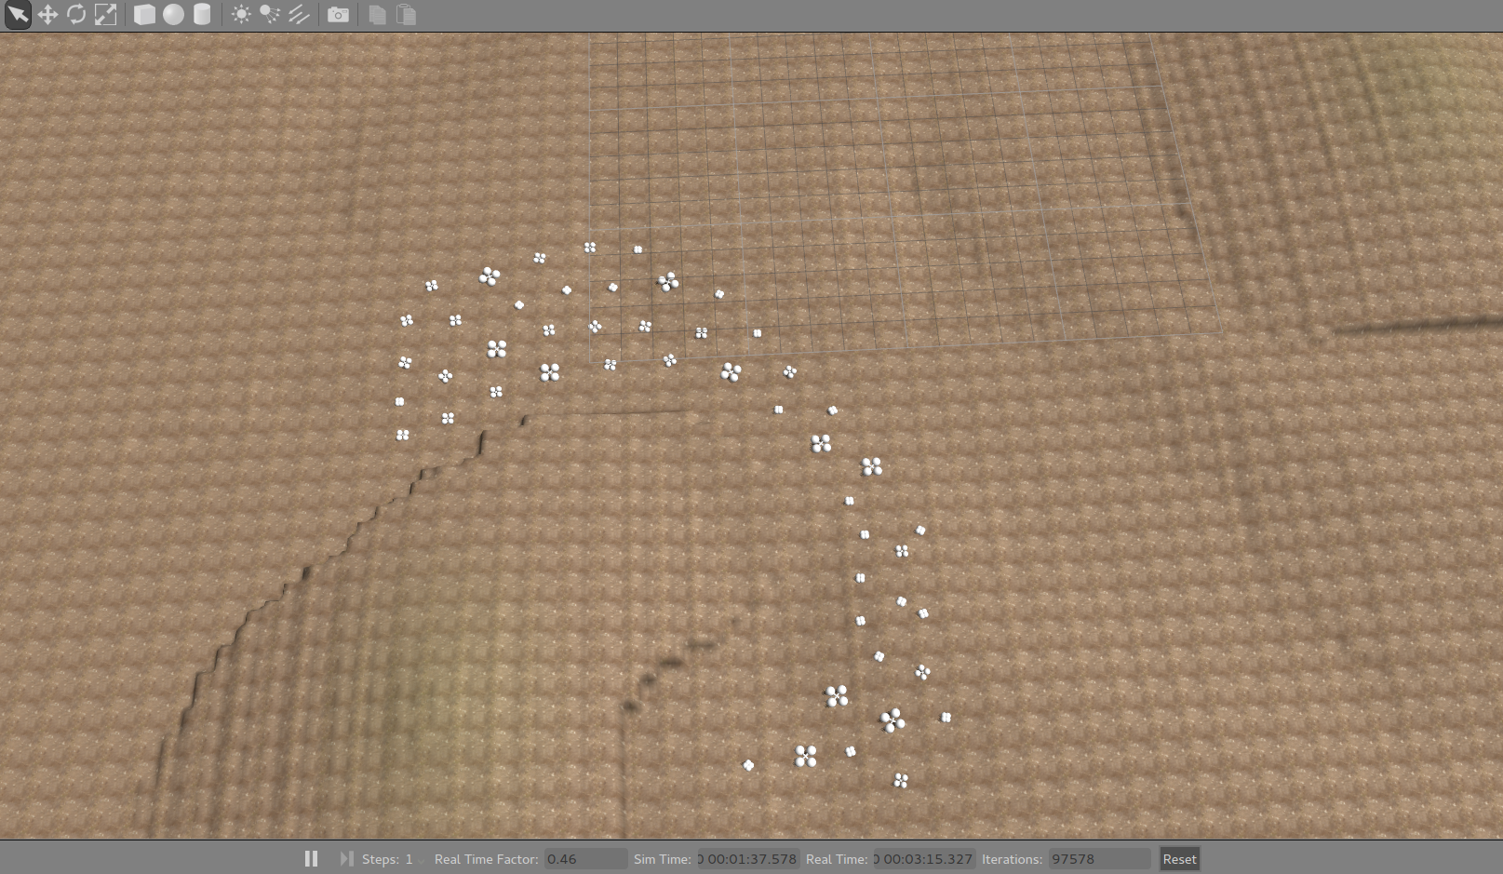
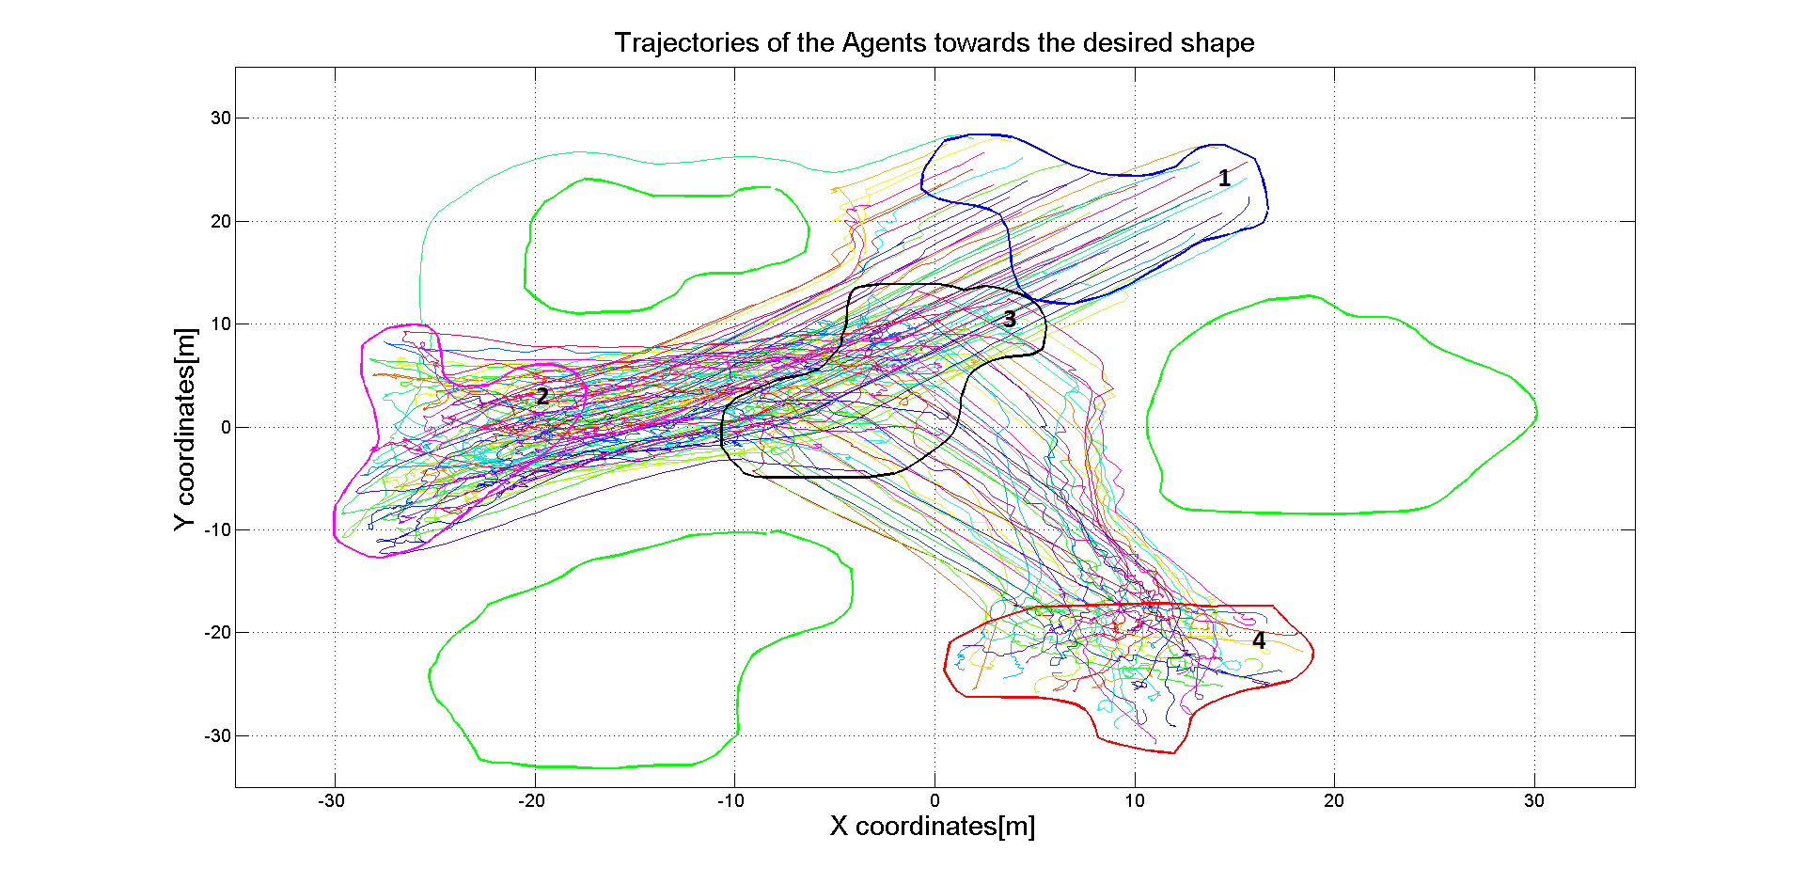
Simulation Results – Various Formation Shape Trials

Slide 21
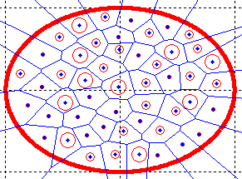
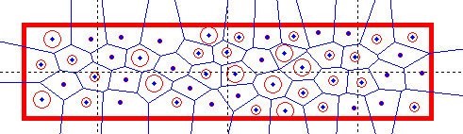
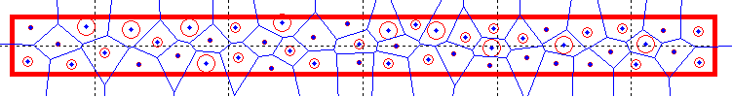
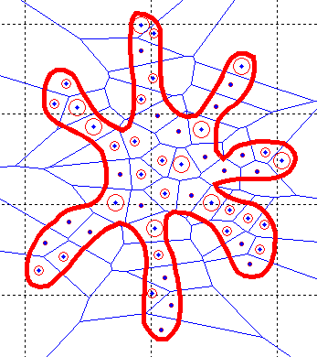
Simulation Results – Sensitivity Analysis
1
Mesh irregularities are expected to be increasing at boundary layers due to discontinuties[17]. It is possible to see this condition with a formation shape dynamically changing its perimeter by keeping its coverage area constant.
2
Shape | Area | Perimeter | Topological Mesh Irregularity
1 | 314[m^2] | 62,8[m] | 2,46
2 | 314[m^2] | 82,8[m] | 2,96
3 | 314[m^2] | 116,82[m] | 3,45
4 | 314[m^2] | 128,36[m] | 3,95
3
4
*In 2D, circle has the minimum perimeter to cover a fixed area[18], thus it has the lowest irregularity.

Slide 22
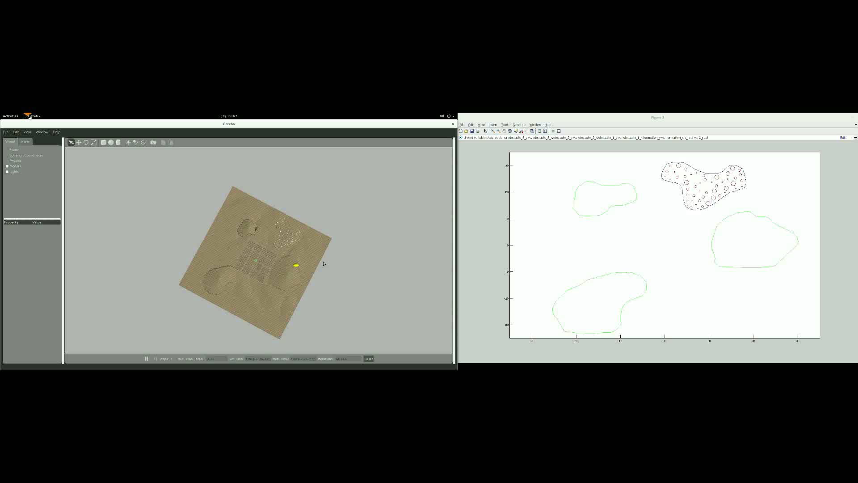
Simulation Results – Dynamical Formation Shapes

Slide 23
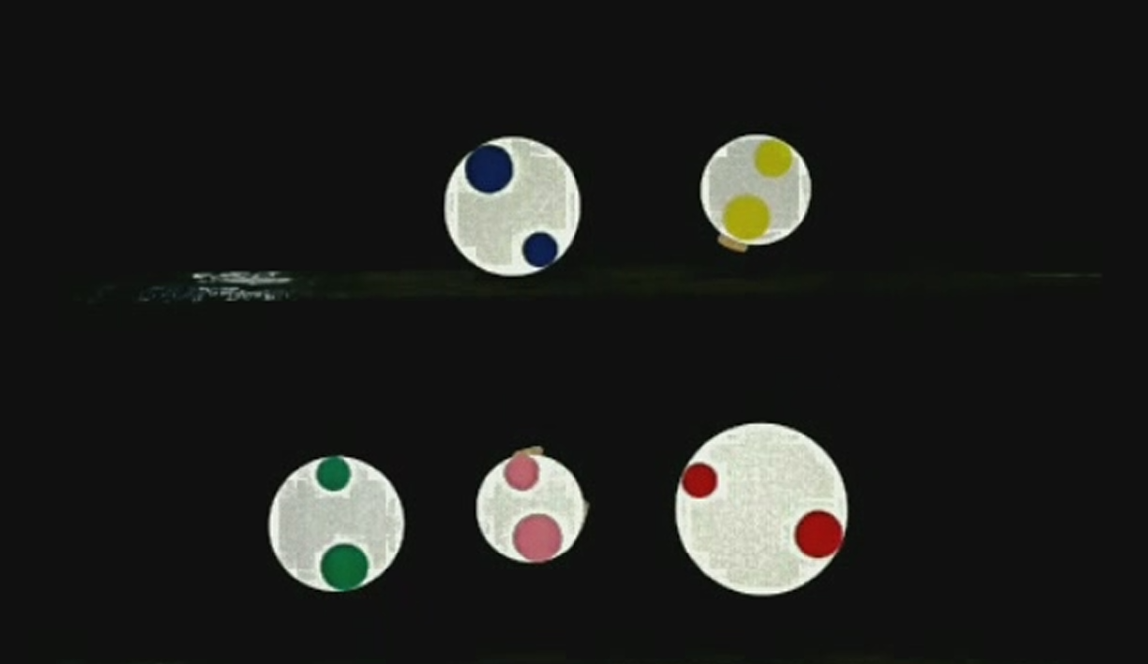
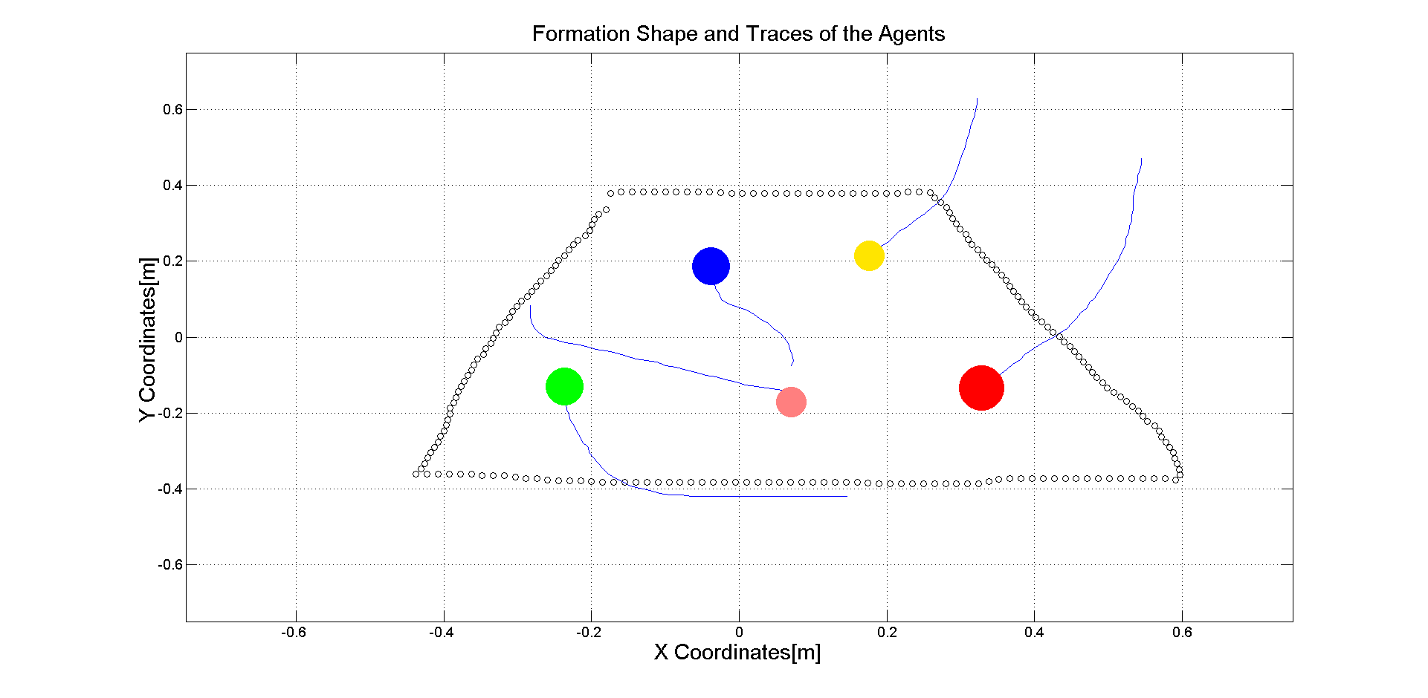
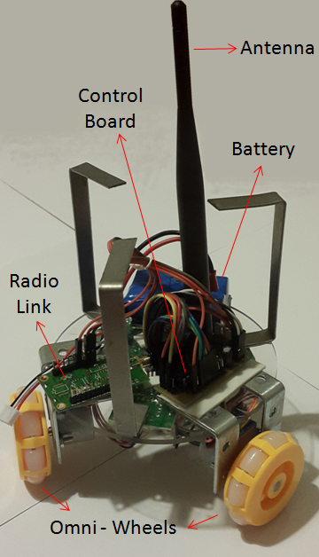
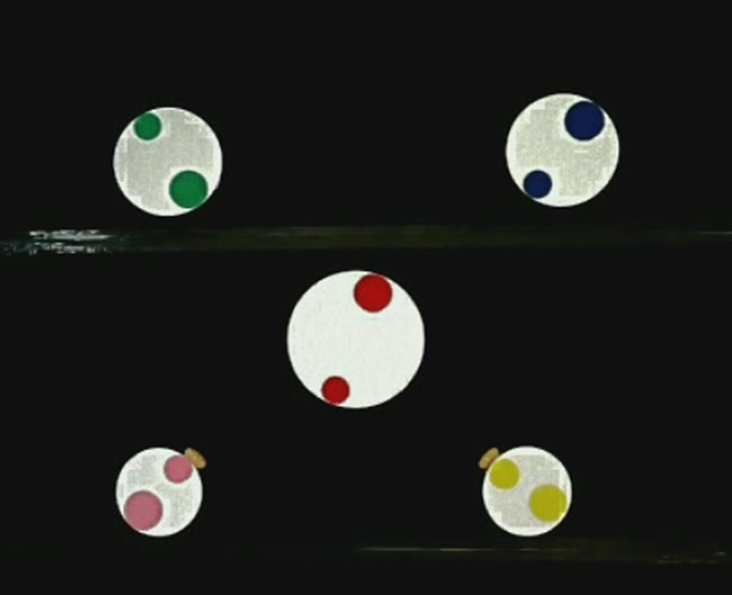





Hardware Implementation Results
Hardware applications which implements the methods discussed in this thesis work are also developed

Slide 24

Hardware Implementation Results

Slide 25
Conclusion
We aim to implement a formation control system with heterogenous agents and complex geometrical shapes which are changing dynamically.
We have designed a decentralized topology in which each agent contributes on decision process.
We have implemented a local positioning system to distribute position data to the second type agents.

Slide 26
Future Works
Hardware implementation will be done with more agents.
Obstacle avoidance is implemented with potential fields. To avoid unwanted equilibrium states, obstacle avoidance feature will be implemented with a more appropriate way (e.g. Tangent bug algorithm).
We use heterogenous agents just to cover different formation shapes. The aim to create formation control with different types of agents is to use their different functionalities. We will try to achieve different missions by using different types of agents after getting the desired formation shape.

Slide 27
References
[1] http://www.eecs.harvard.edu/ssr/projects/progSA/kilobot.html
[2] Martin N, Klupar P, “Techsat 21 And Revolutionizing Space Missions Using Mıcrosatellıtes”,
[3] http://www.swarmanoid.org/swarmanoid_hardware.php.html
[4] S Kornienki, O. Kornienko, and Levi. P. Minimalistic approach towards communication
and perception in microrobotic swarms. In IEEE International Conference on Intelligent Robots and Systems, 2005.
[5] Farshad Arvin, John Murray, Licheng Shi, Chun Zhang, and Shigang Yue. Development
of an autonomous micro robot for swarm robotics. In IEEE International Conference on Mechatronics and Automation, 2014.
[6]Touraj Soleymani, Vito Trianni, Michael Bonani, Francesco Mondada, and Marco Dorigo. Bio-inspired construction with mobile robots and compliant pockets. Robotics and Autonomus Systems, 74:340–350, 2015.
[7] Roderich Grof, Michael Bonani, Mondada Francesco, and Marco Dorigo. Autonomous
self-assembly in a swarm-bot. 22:1115–1130, 2006.
[8] S.P. Hou, C.C. Cheah, and J.J.E. Slotine. Dynamic region following formationcontrol for a swarm of robots. In ICRA, 2009.
[9] Samitha Ekanayake and Pubudu Pathirana. Formations of robotic swarm: An artificial force based approach. International Journal of Advanced Robotic Systems,7:173–190, 2010
[10] http://electronicdesign.com/systems/advanced-robots-swarm-nyc-s-museum-math
[11] Aveek Das, Rafael Fierro, Vijay Kumar, James Ostrowski, John Spletzer, and Camilla Taylor. A vision-based formation control framework. IEEE Transactions on Robotics and Automation, 18:813–825, 2002.
[12] Kenji Shimada and David Gossard. Bubble mesh: Automated triangular meshing of non-manifold geometry by sphere packing. In ACM Symposium on Solid Modeling and Applications, 1995.
[13]John Shier and Paul Bourke. An algorithm for random fractal filling of space.Computer Graphics Forum, 32:89–97, 2013.
[14] Mark Berg, Otfried Cheong, Kreveld. Marc, and Marc Overmars. ComputationalGeometry. Springer, 1998.
[15] https://nevraa.wordpress.com/2012/08/08/dijkstra-algoritmasi-ile-en-kisa-yol-bulma/
[16] Jop Frederik Sibeyn. Graph algorithms. https://www8.cs.umu.se/ jopsi/dinf504/chap14.shtml, last visited on April 2016.
[17] Richard, Pletcher and John C. Tannehill, Computational Fluid Mechanics and Heat Transfer, Third Edition
[18] B.V. Ramana, Higher Engineering Mathematics, The McGraw Hill Companies

Slide 29



Formation Control System
Bubble Packing and Randomized Fractals Methods
Velocity Controller
The dynamical system of agents is augmented with an artificial error state, to design an State feedback with LQR controller;
Q and R matrices used in solving Riccati equations,
where,

Slide 30
Local Positioning System (LPS)
2)Route Table Determination
DSDV is a table driven routing scheme based on Bellman Ford algorithm
Used to create wireless mesh networks and ad-hoc mobile networks
Solves routing loop problem in route table algorithms
Route table for agent 2
Routing Loop Problem
Destination | Next Hop | Metric | Dest. Seq. No
1 | 1 | 1 | 123
3 | 3 | 2 | 516
4 | 4 | 1 | 212
5 | 4 | 2 | 168
6 | 8 | 3 | 372
7 | 8 | 2 | 432
(D,5)
(D,4)
(D,4)
(D,3)
(D,2)
(D,2)
3
5
A
B
C
D
4
Dest. | Next | Metric
… | … | …
D | B | 3, 5, …
Dest. | Next | Metric
… | … | …
D | B | 3, 5, …
Dest. | Next | Metric
… | … | …
D | C | 2, 4, 6,..
6
1
2
7
8

Slide 31
Local Positioning System (LPS)
1)Local trilateration
Return to Home Mode
Lost agent aims to
arrive to this point
Movement in real world
Agent’s real
position
Agent’s wrong
position
Estimated movement to
the formation center

Slide 32

Local Positioning System (LPS)
1)Local trilateration
The solution of the position(P(x,y,z)) with the help of positions of neighbors can be reduced to a problem of;
We have an A matrix with a dimension of [n-1] x 2 (where n is the number of neighbors). There are three options for the solution of the problem related with the condition of A matrix,
1) , unique solution (if there are 3 neighbors and A is full column rank matrix)
2) , , minimum norm solution (if there are more neighbors and A is full column rank matrix
3) Find the minimum error/norm solution with nonlinear least squares method, if rank(A) = 1

Slide 33


Formation Control System
Bubble Packing and Randomized Fractals Methods
Decision of Goal States
1)Calculation of Free Configuration Space
2)Visibility Graphs
The shortest path between a start and goal among a set S of augmented polygonal obstacles consists of arcs of the visibility graph
[14]
Forbidden Space :
[14]
[14]
Forbidden Space
Visibility Graph

Slide 34
Formation Control System
Bubble Packing and Randomized Fractals Methods
Decision of Goal States
3)Dijkstra’s Algorithm
4)Hungarian Algorithm (Munkres Assignment Algorithm)
Dijkstra's algorithm is a tree search algorithm for finding the shortest paths between nodes in a graph
The shortest path between a start and goal among a set S of augmented polygonal obstacles consists of arcs of the visibility graph
 | Clean Bathroom | Sweep Floors | Wash Windows
Jim | $3 | $2 | $7
Steve | $2 | $5 | $3
Alan | $4 | $3 | $2
[15]
Calculation of Minimum Shortest Path From A to K
[16]

Slide 35
Local Positioning System (LPS)
2)Local trilateration
Lost agent handling rules;
An agent is called ‘lost’ when it doesn’t have minimum 3 position beacons as neighbors
If an agent is lost it cannot enter the localization process, and it enters ‘Lost’ mode in which it is directed to the center of formation shape.
Lost

Slide 36



Results
Local Positioning System (LPS)

Slide 37


Simulation Results – Sensitivity Analysis
1
2
3
6
5
4

